Slide 1
Topic:Multiplication EQ: What strategies can we use to multiply?
Year 11 Essentials

Slide 2
Things Required For This Lesson
Interactive Notebook
Textbook: Interleaved Maths Essential Connections
Ruler, Red Pen, Pencil, Pens, Scientific Calculator
Growth mindset
Graph paper

Slide 3

24
7
30
Topic: Multiplication
Date: 12/02/2021
EQ: What strategies can we use to multiply?
WICOR
This Photo by Unknown Author is licensed under CC BY-SA

Slide 4

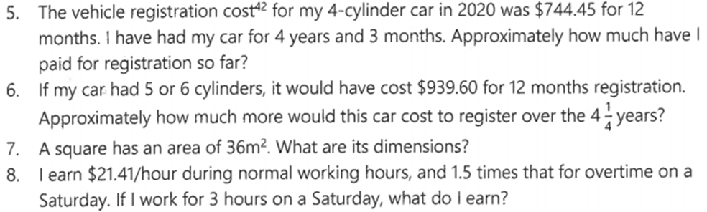
Interleaved Questions page 134 set 3

Slide 5
Activity
1. Using graph paper make as many rectangles as you can using exactly 36 squares
2. Write the dimensions of each rectangle
Possible answers: 36x1, 18x2, 12x3, 9x4, 6x6

Slide 6
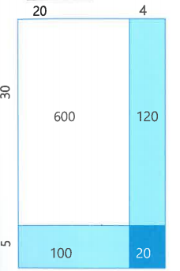
24
7
30
Topic: Multiplication
EQ: What strategies can we use to multiply?
Using arrays to multiply
Multiply 24 by 35
Partition the numbers on an array
Multiply each section
Add together
600+120+100+20=840
So 24x35=840
Multiplying by partitioning
If you struggle with times tables like the 7 times tables you can partition the 7 to make it easier.
6x7= 6x(2+5)
=42
 | 2 | 5
6 | 12 | 30
 | 3 | 4
6 | 18 | 24
WICOR
12+30=42
18+24=42

Slide 7
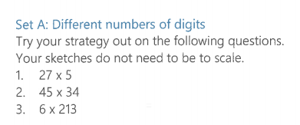
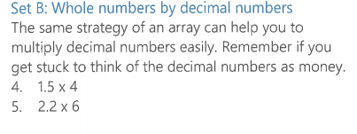
LHS: page 21 interleaved textbook
Worded Problem
A gym membership costs $23 per.
How much would it cost for;
A fortnight?
A year?
Per month

Slide 8
LHS: page 21 interleaved textbook
135
1530
1278
Worded Problem
A gym membership costs $23 per.
How much would it cost for;
A fortnight?
A year?
Per month
$46
$1196
$99.65
6
13.2

Slide 9
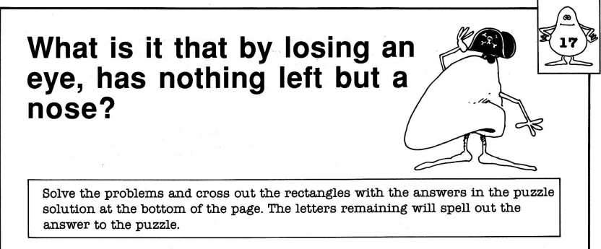
Complete the worksheet to solve the puzzle

Slide 10

Thank you
Keep up the good work!
Quote of the day –
“Look to my coming, at first light, on the fifth day. At dawn, look to the East.”- Gandalf

